Slide 1
MAT224 for AL SPOKE
Ananth Sheshadri Kishore Pydimarry
Engineer Engineer (HRA-Assoc)
Mat 04, 2012

Slide 2
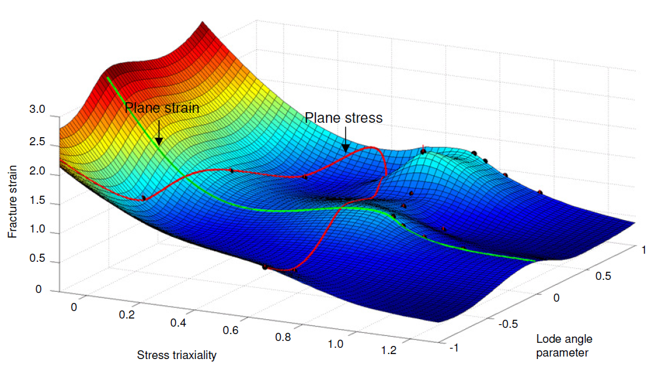
Why MAT224
Material Fracture – LS-DYNA
MAT24
MAT224
Fracture is not based on Statr of Stress (SOS).
Material separation occurs even if state of stess is compression.
Underpredicts fracture even when its supposed to not to fail
Fracture surface can be developed based on different States of Stresses (SOS). Plastic strain to failure can be input as a function of
Tension SOS
Compression SOS
Shear SOS
Bi-axial SOS
Combined modes SOS
Fracture strain is dependent on mesh-size of the model through a regularization curve
Needs extensive material testing to collate data for each state of stress. SOS is defined by triaxiality and Lode parameter
No damage and No anisotropy considered
Similar to mat24 till necking

Slide 3
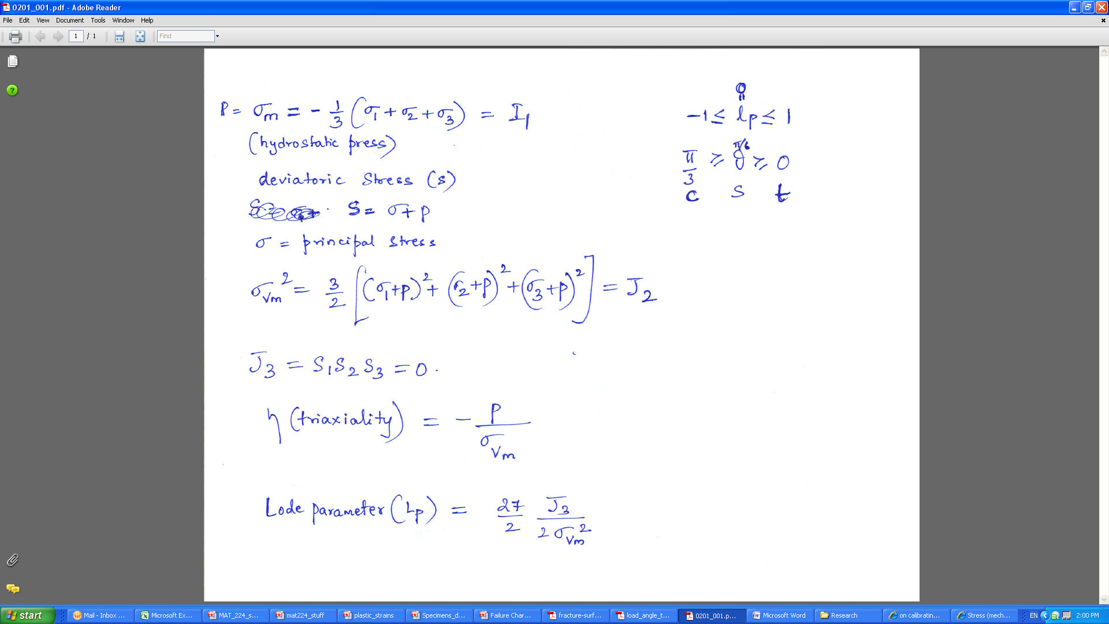
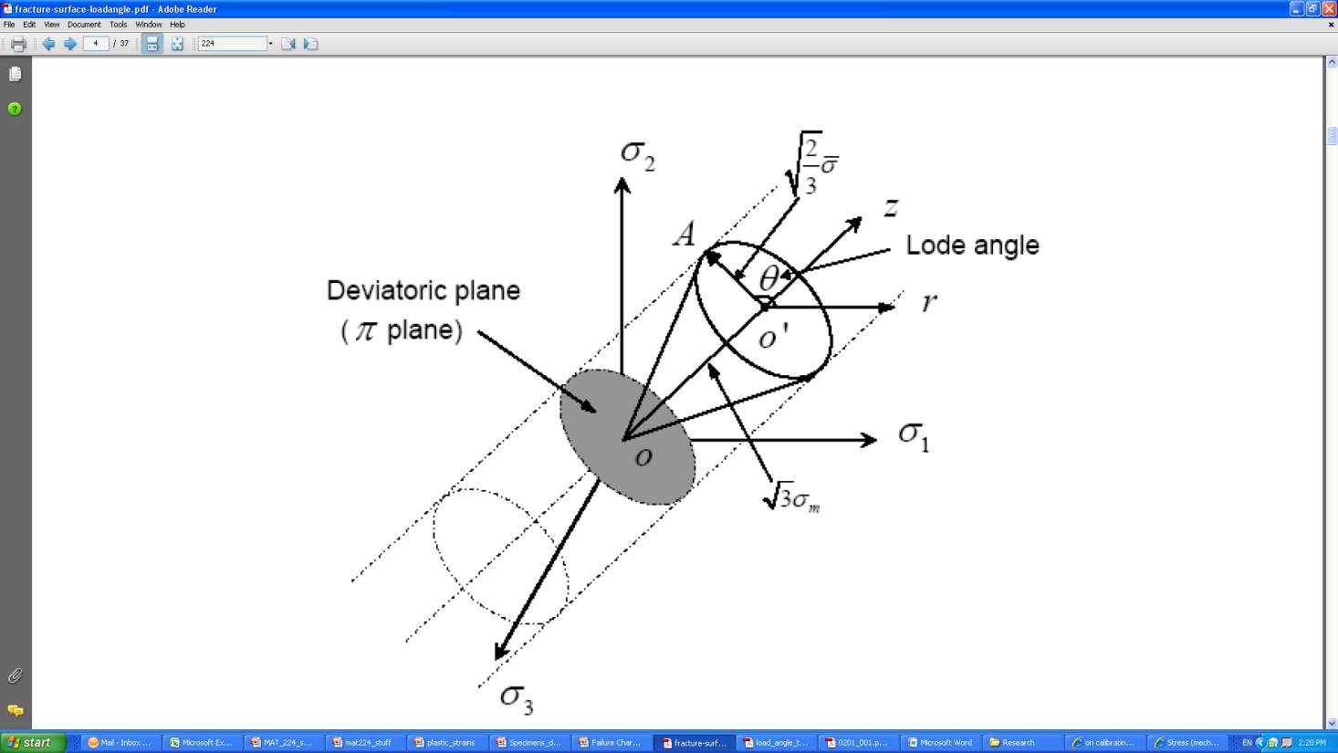
Triaxiality and Lode Parameter
vm

Slide 4
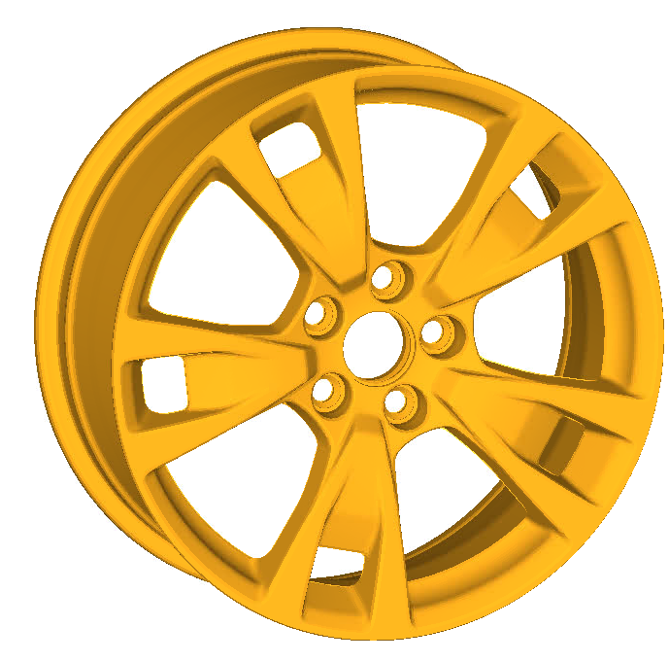
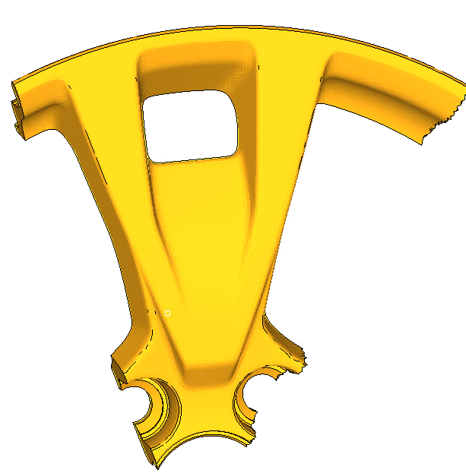
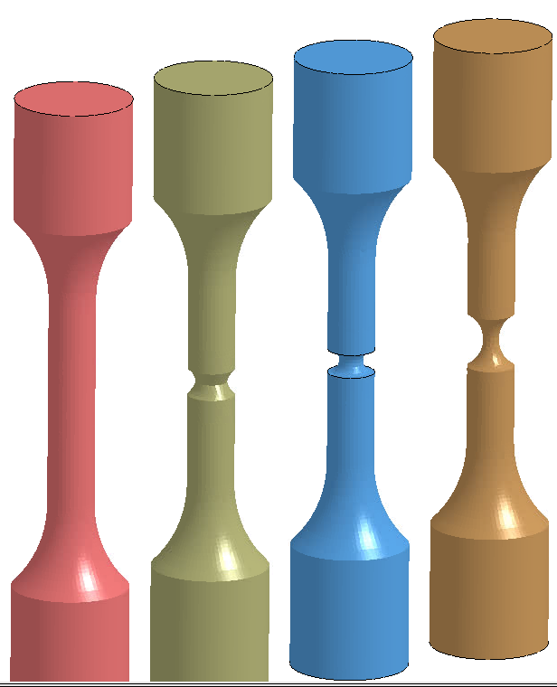
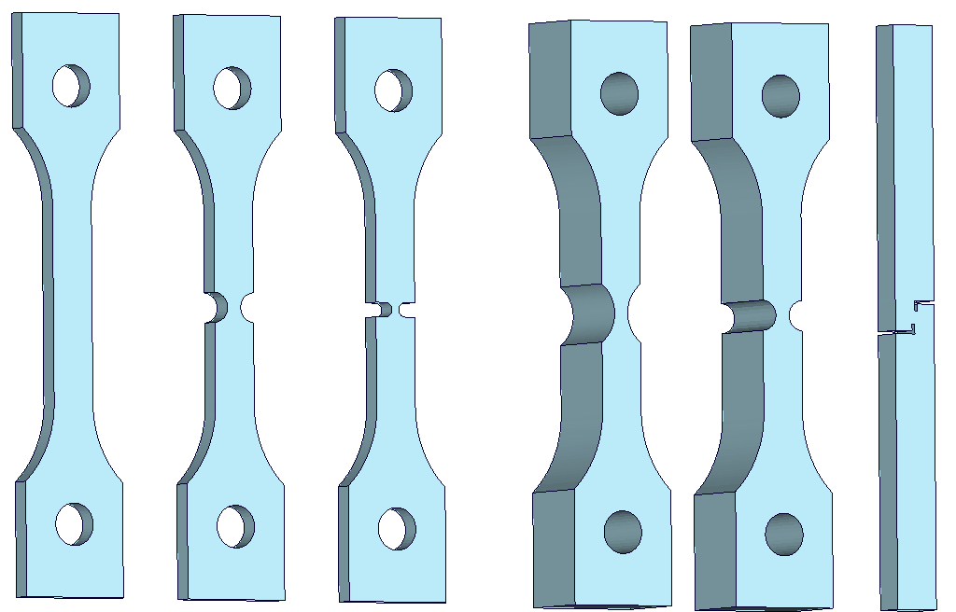
Specimens Cut from Wheel
Full Wheel
Approx final cut shapes @ Honda tossed to IMR for machining
1
2
5
3
4

Slide 5
Different coupon test specimens
S1
S2
S3
T1
T2
Shear
A1
A2
A3
A4
Plane stress specimens
Plane strain specimens
Axi symmetric specimens

Slide 6
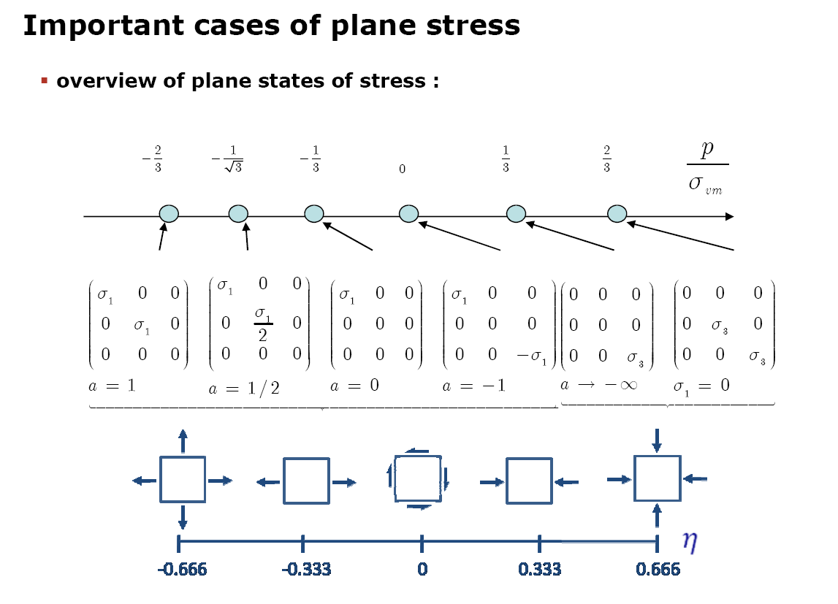
Triaxiality State of Stress
(triaxiality)

Slide 7
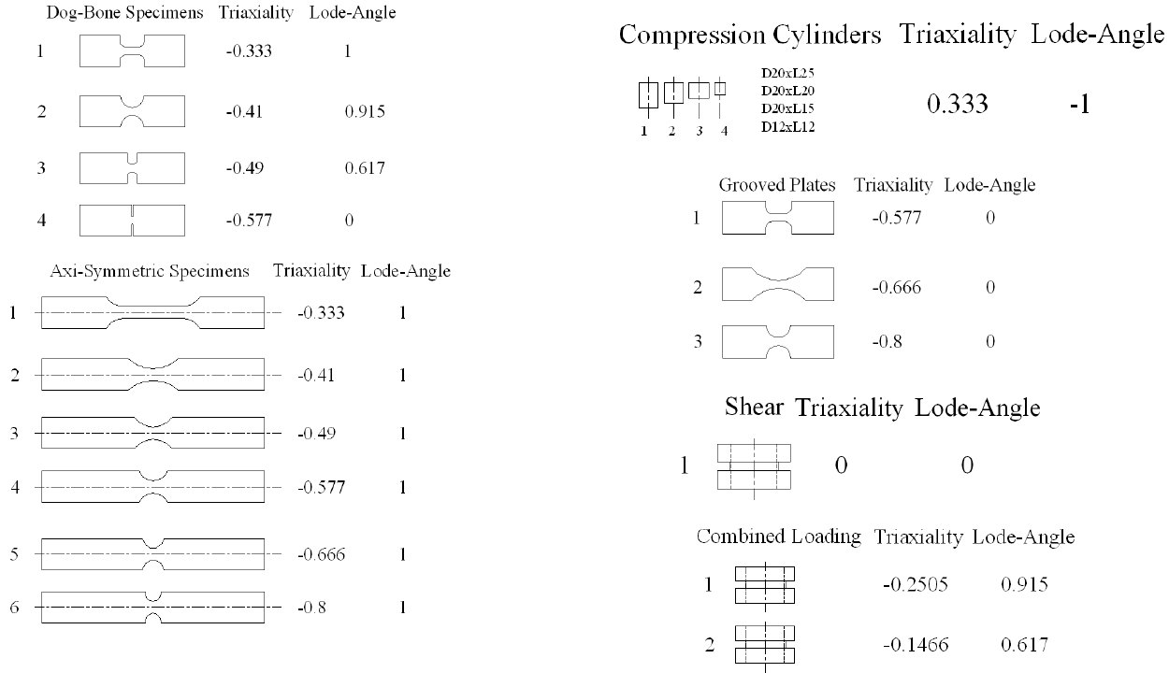
Typical Triaxiality and Lode values
Compression
specimens
Plane stress specimens
Plane Strain specimens
Axisymmetric
specimens
Shear
specimens

Slide 8
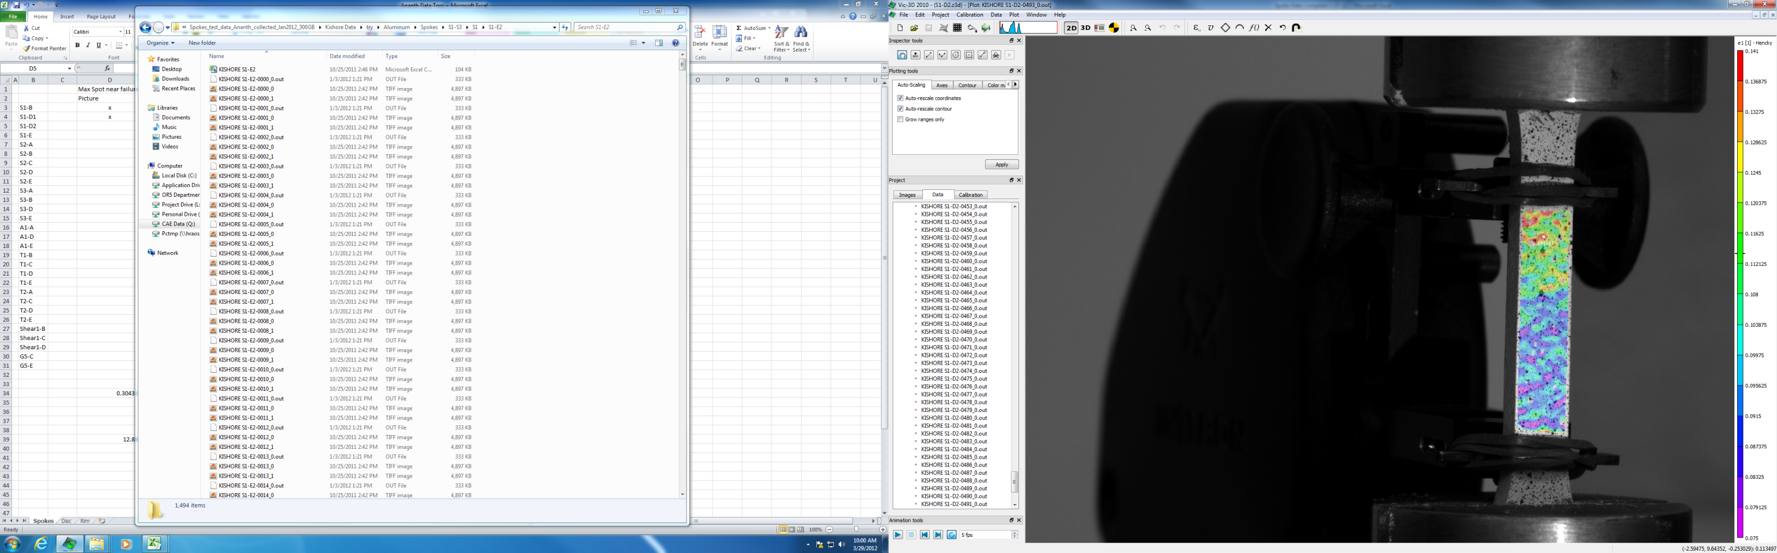
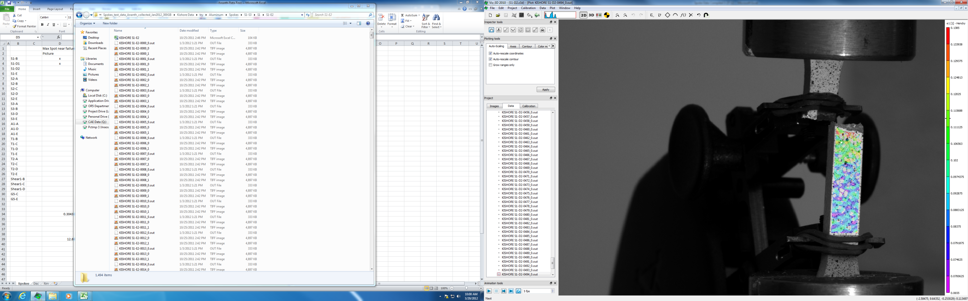
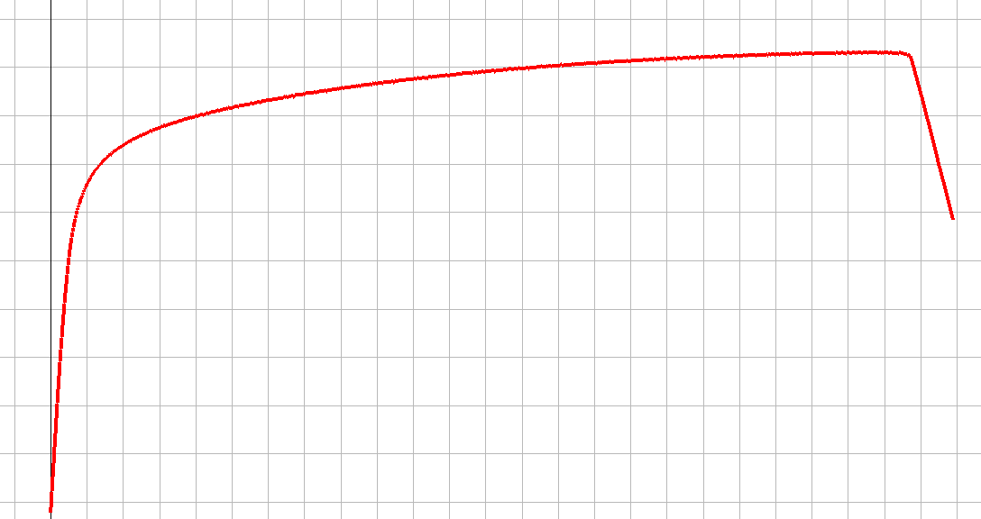
Tensile testing and DIC
S1
Ep (spot value - surface) = 0.141
Ep (ratio method - inner) = 0.1511
Ep (MAT24 fit) = 0.16
used
Triaxiality and Lode based on MAT24 fit
Triax = -0.33
Lode = 1.0

Slide 9
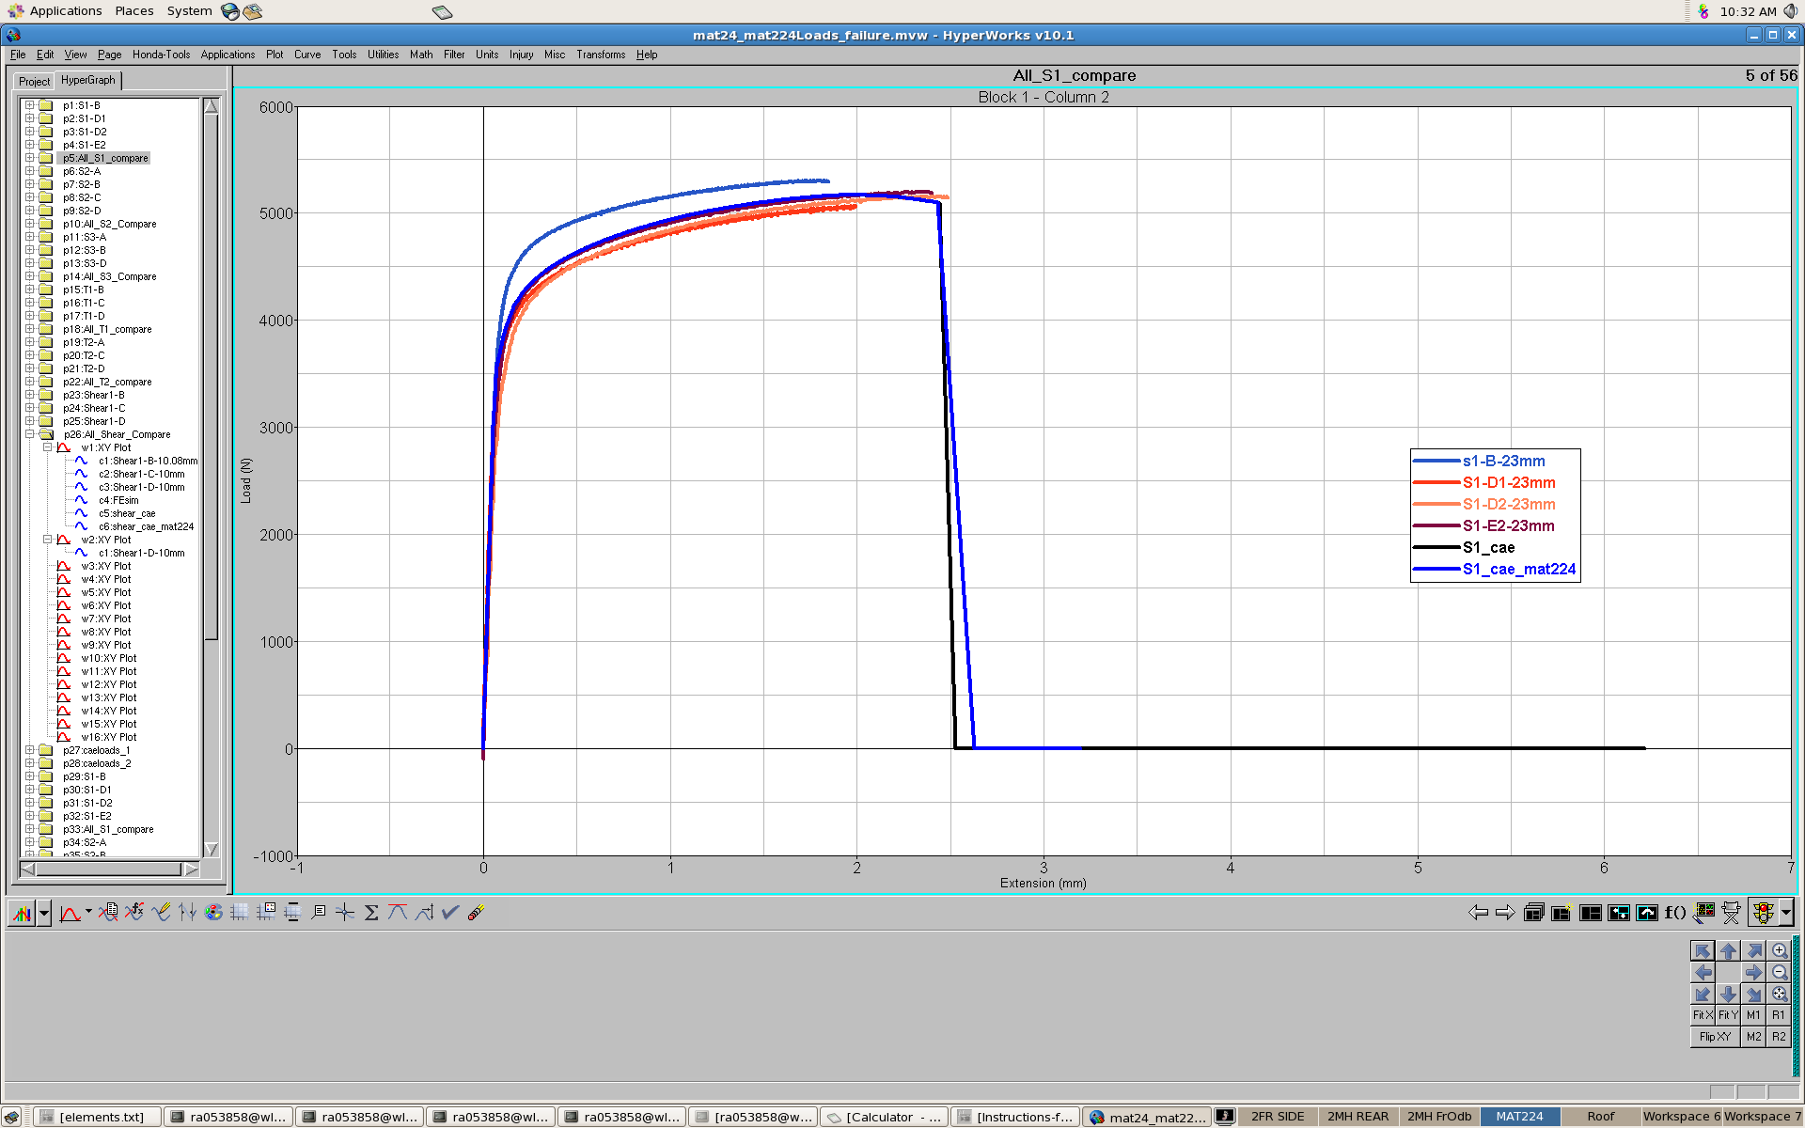
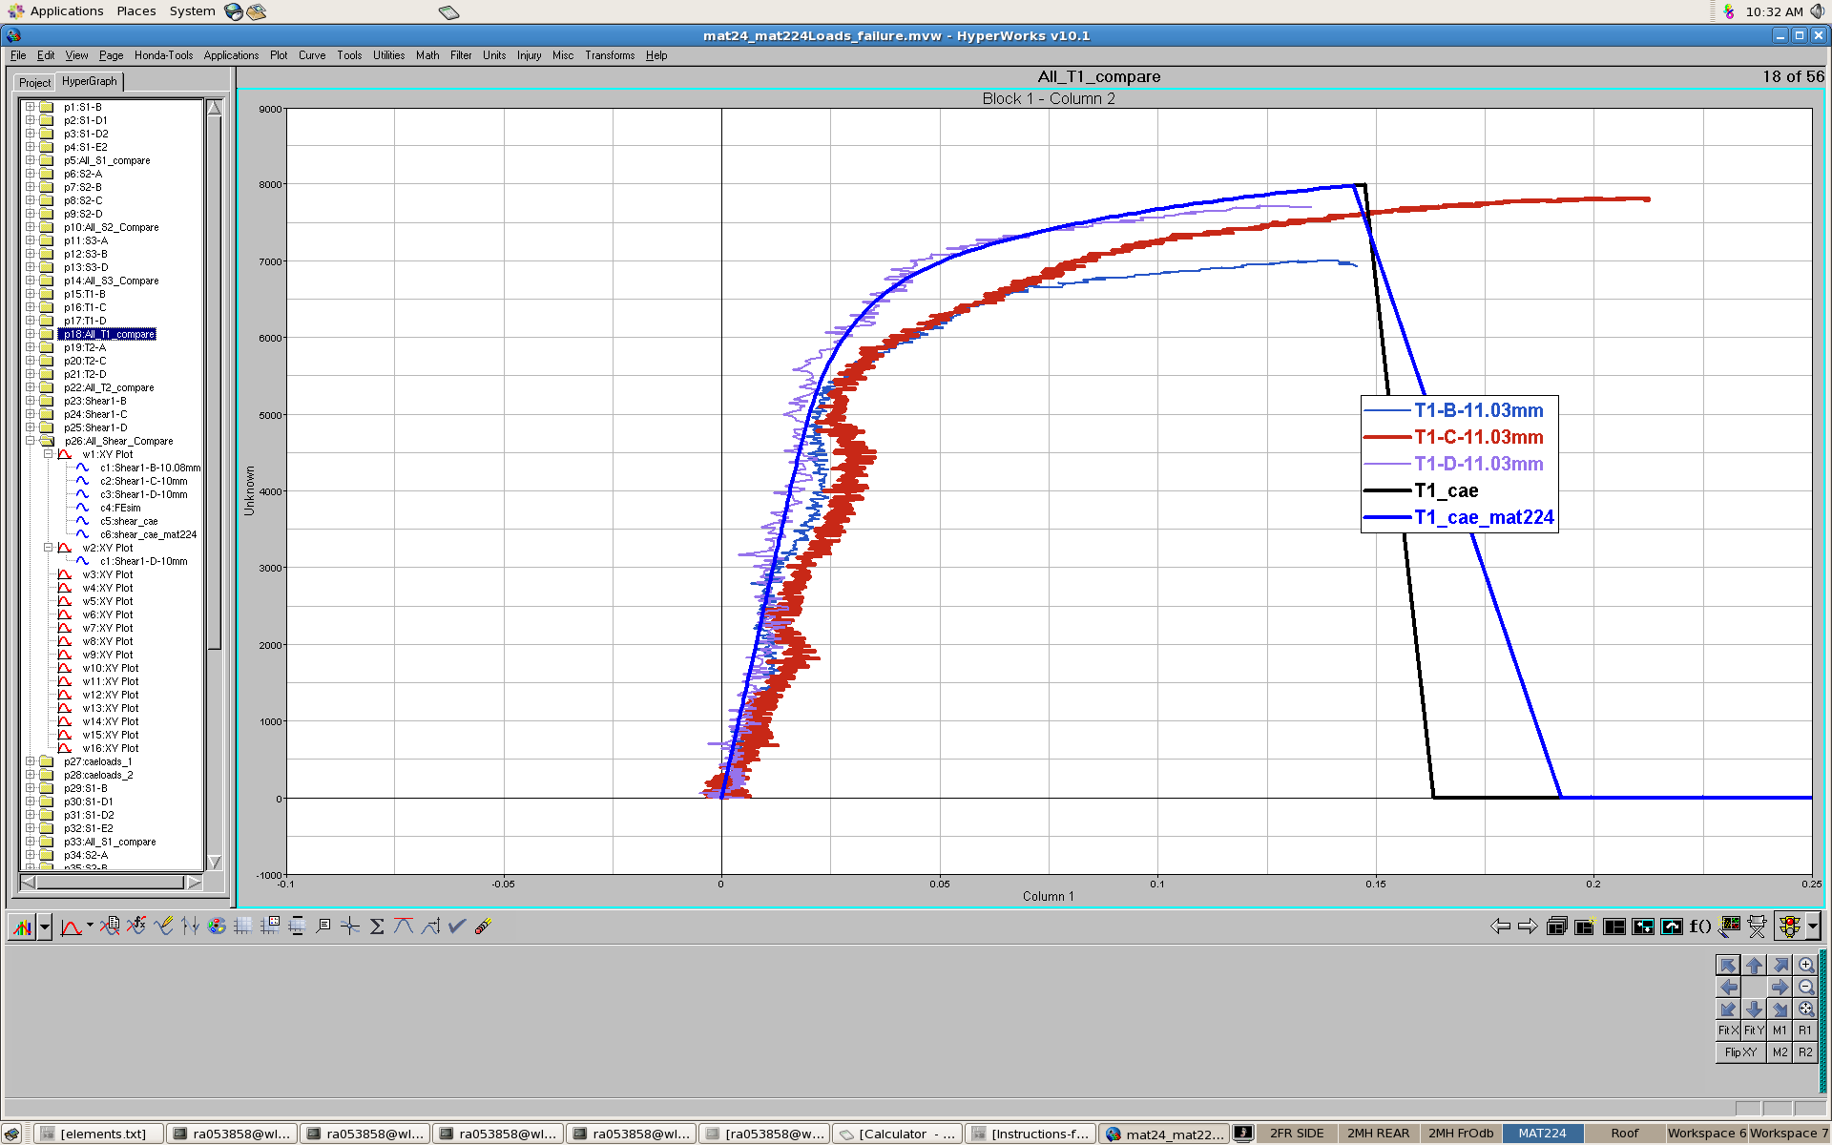
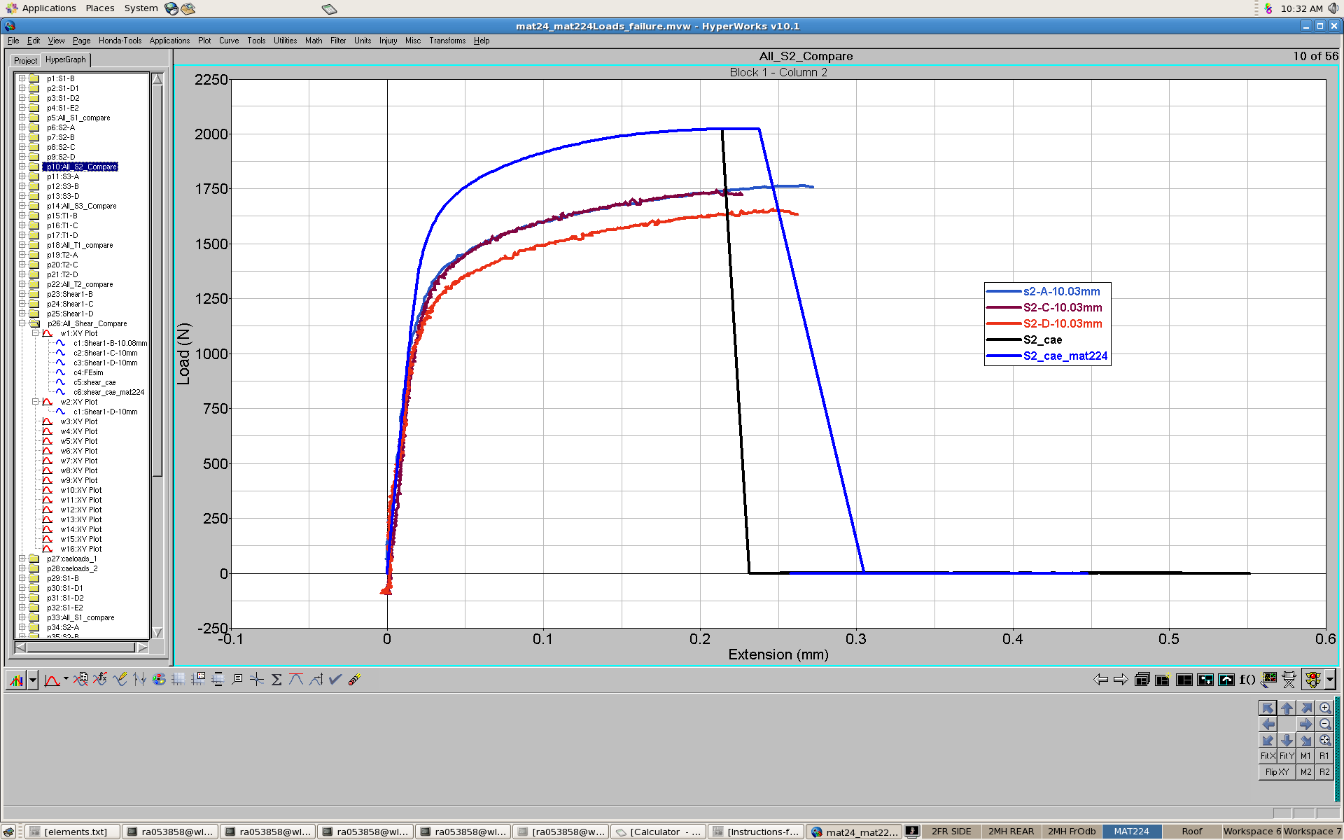
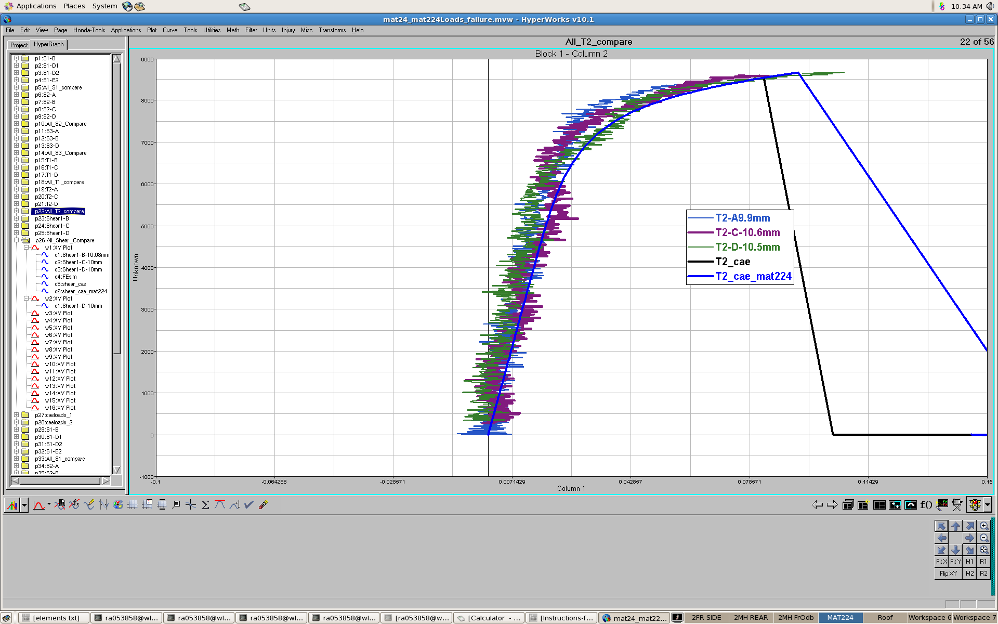
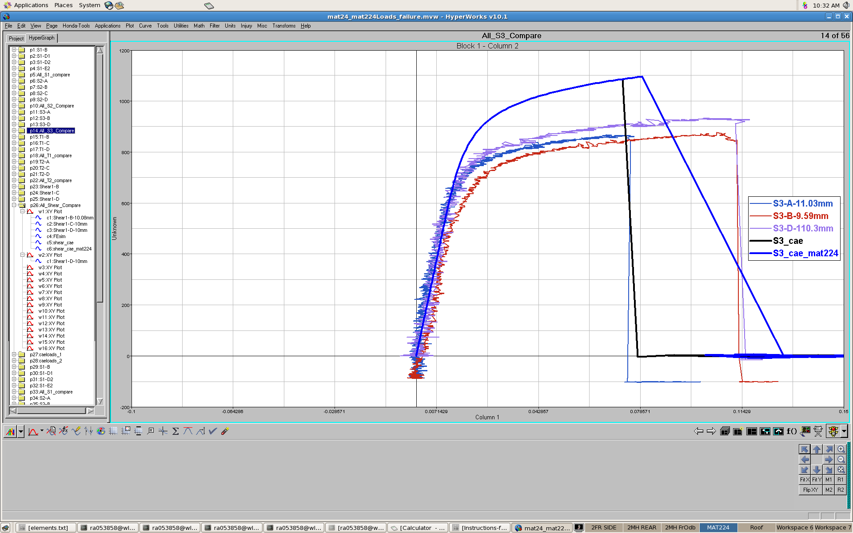
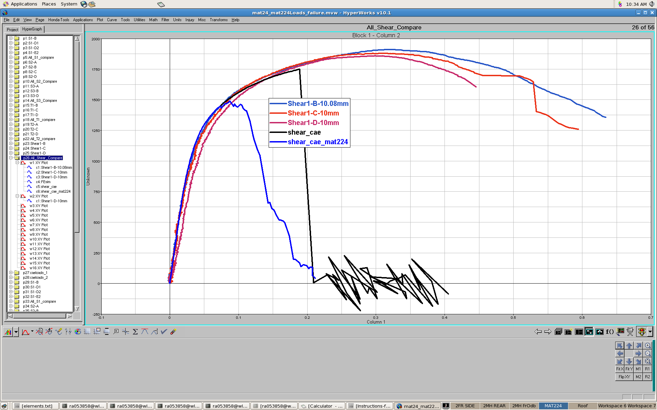
MAT24,224 PS –0.25mm hexmesh
S1
T1
S2
T2
S3
Shear

Slide 10
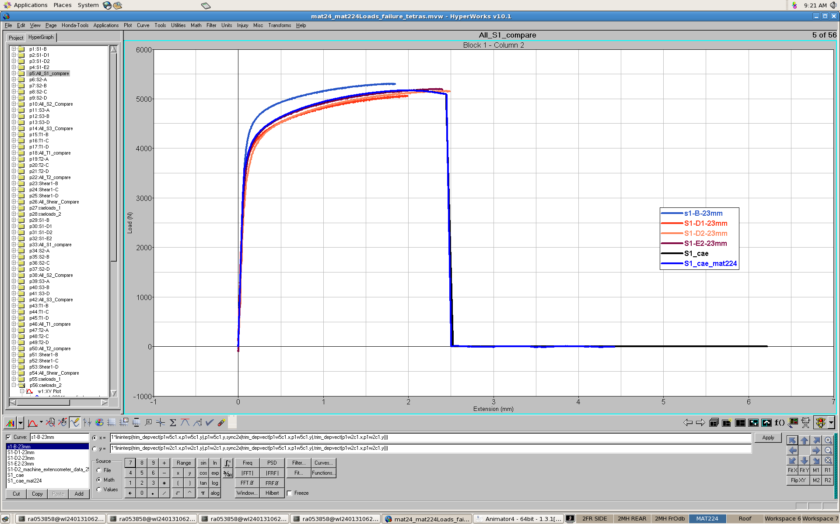
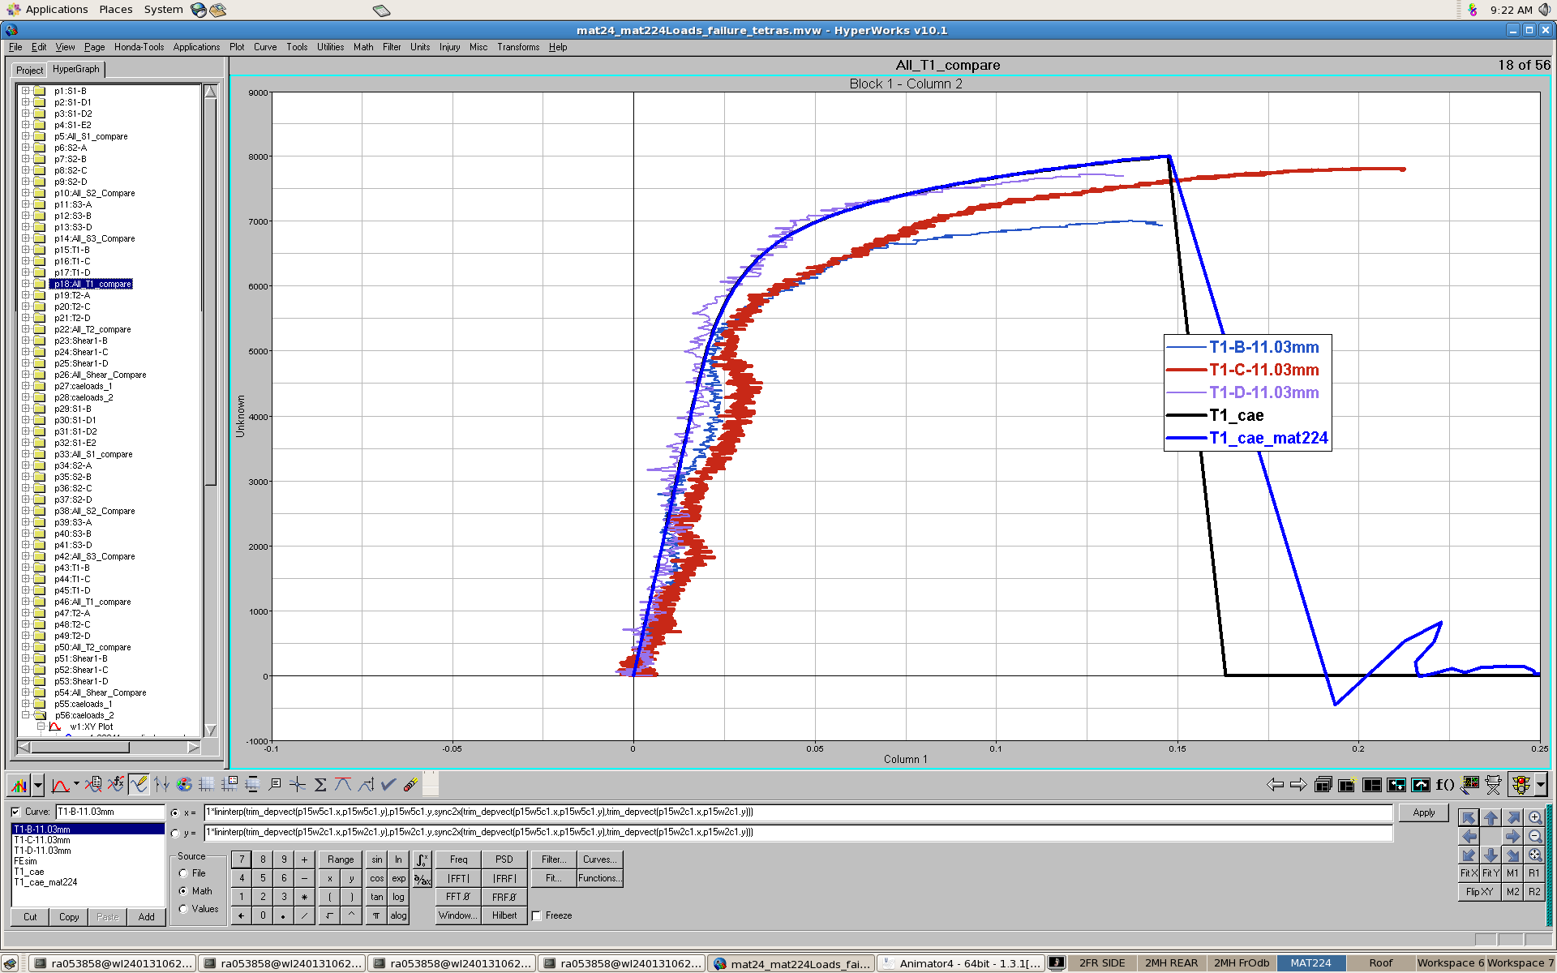
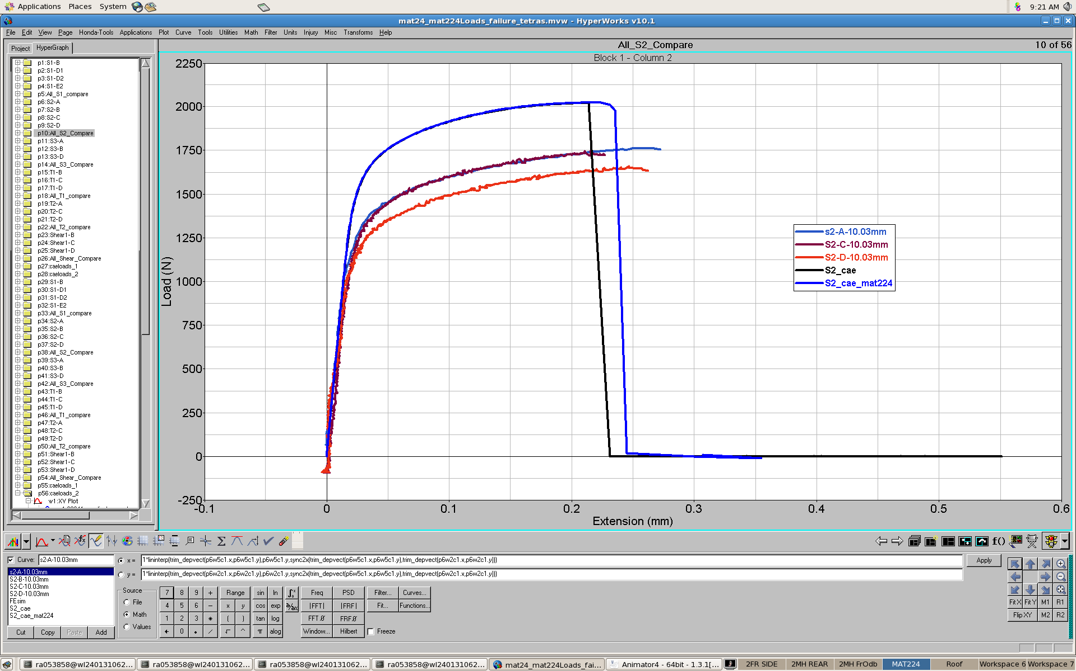
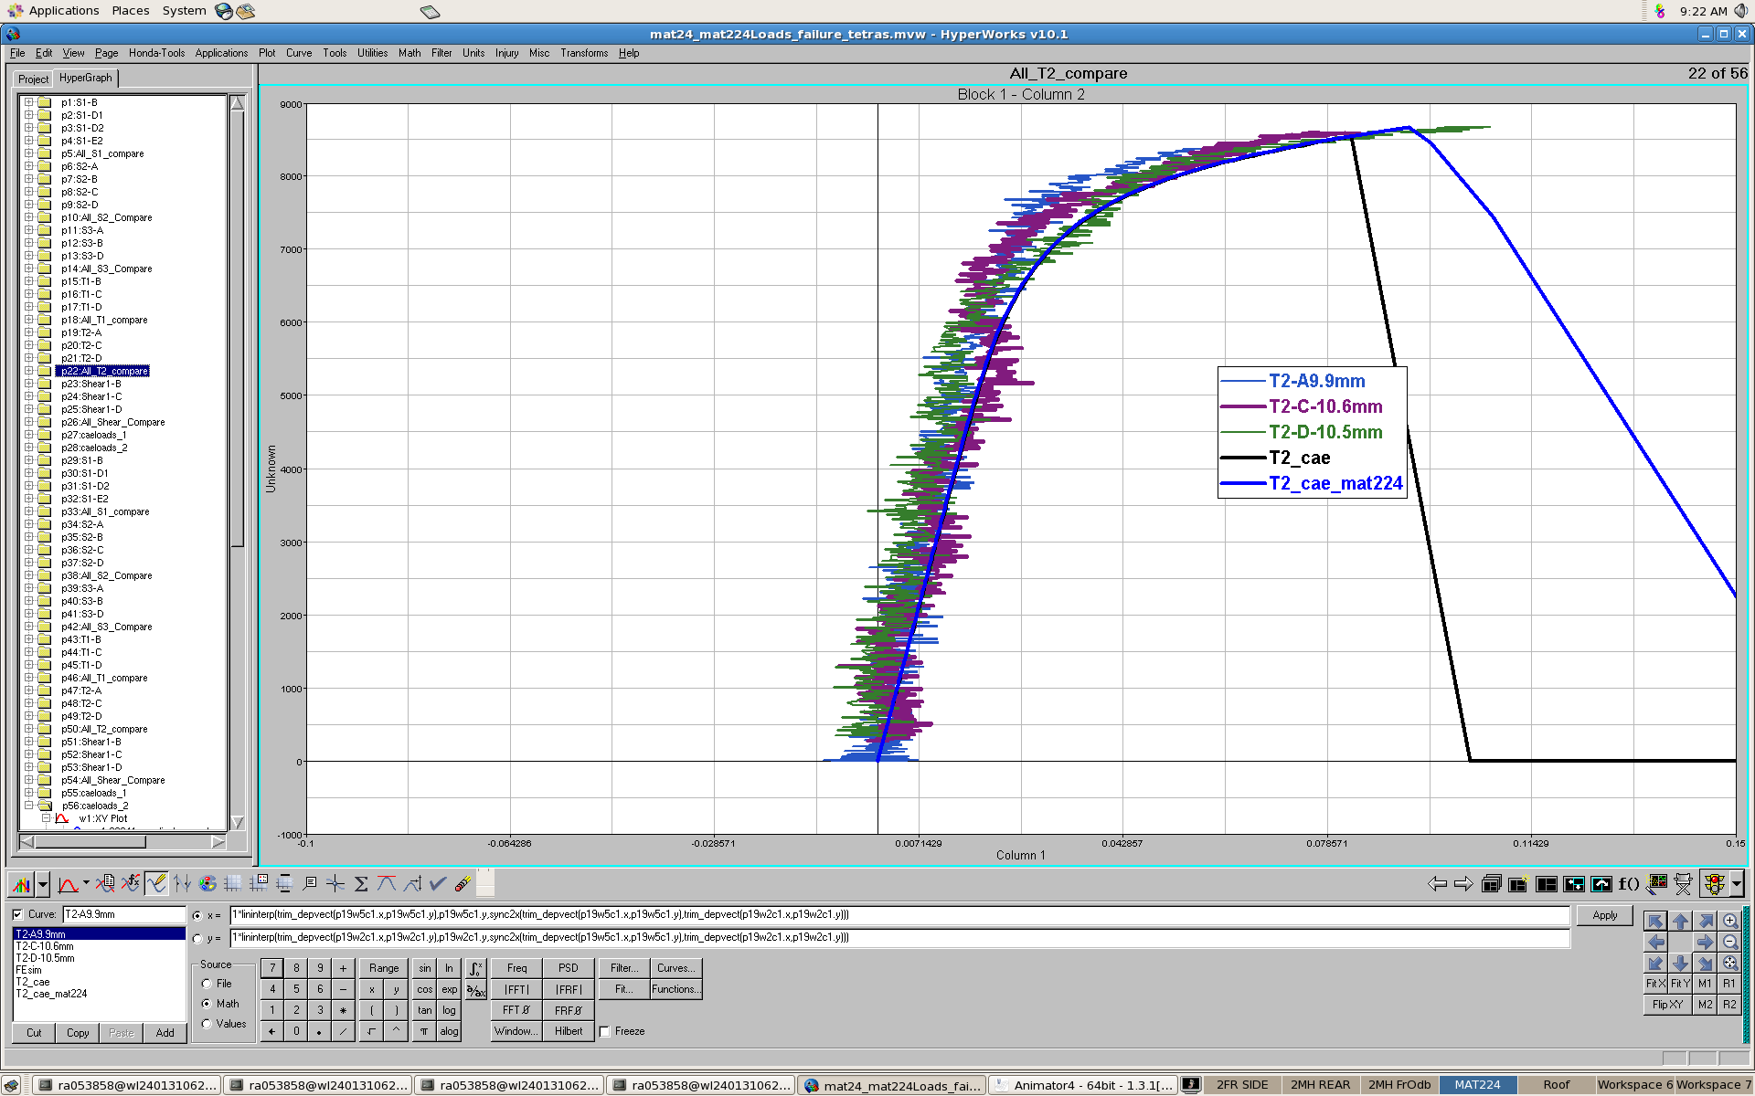
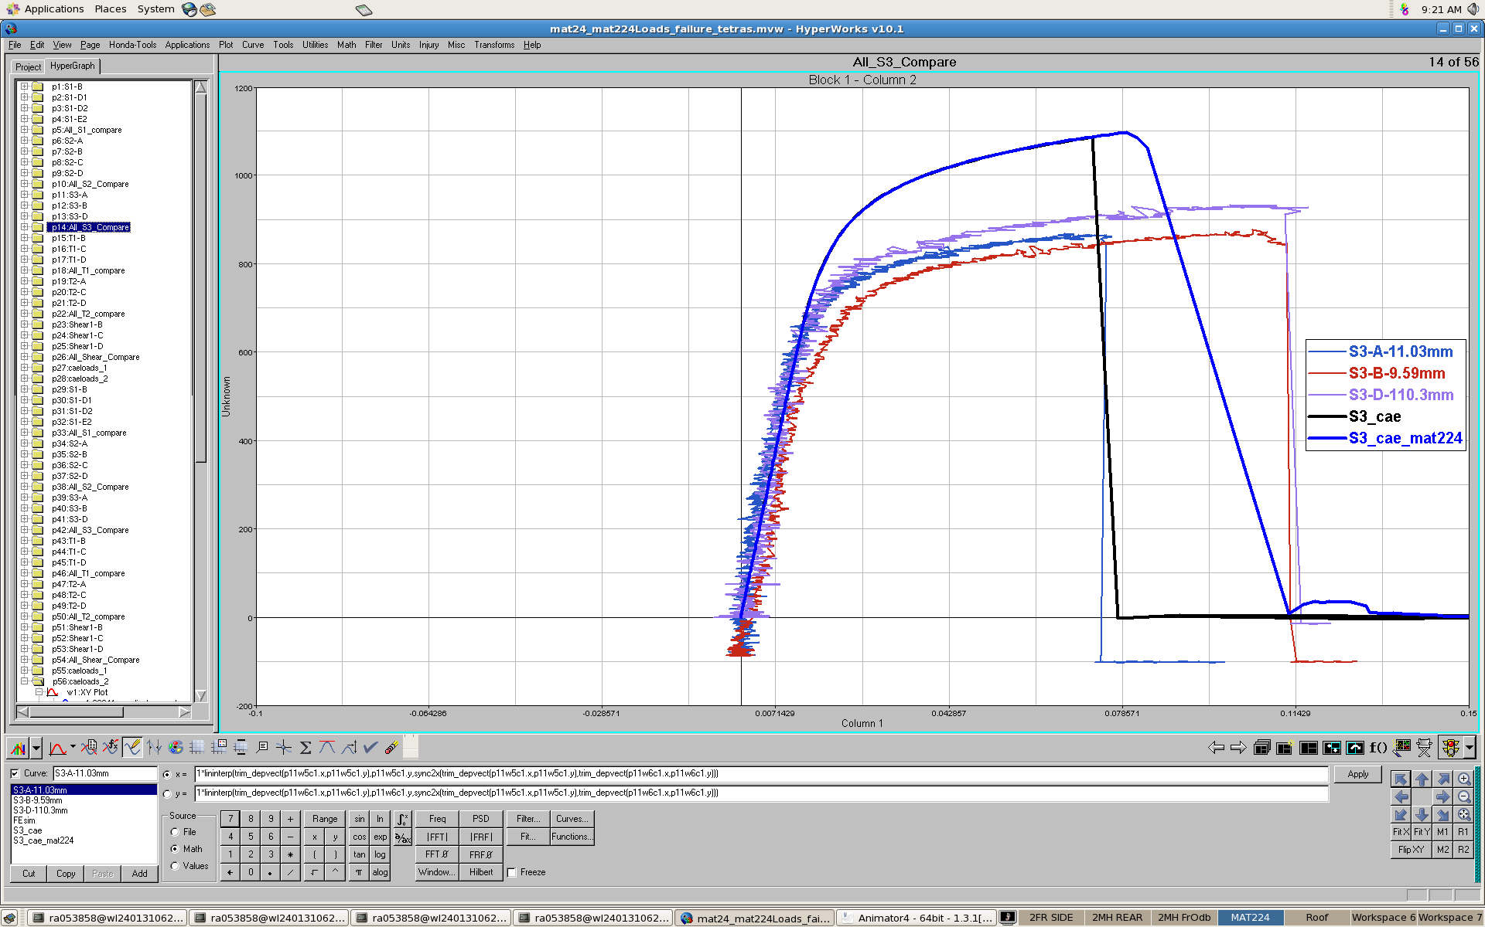
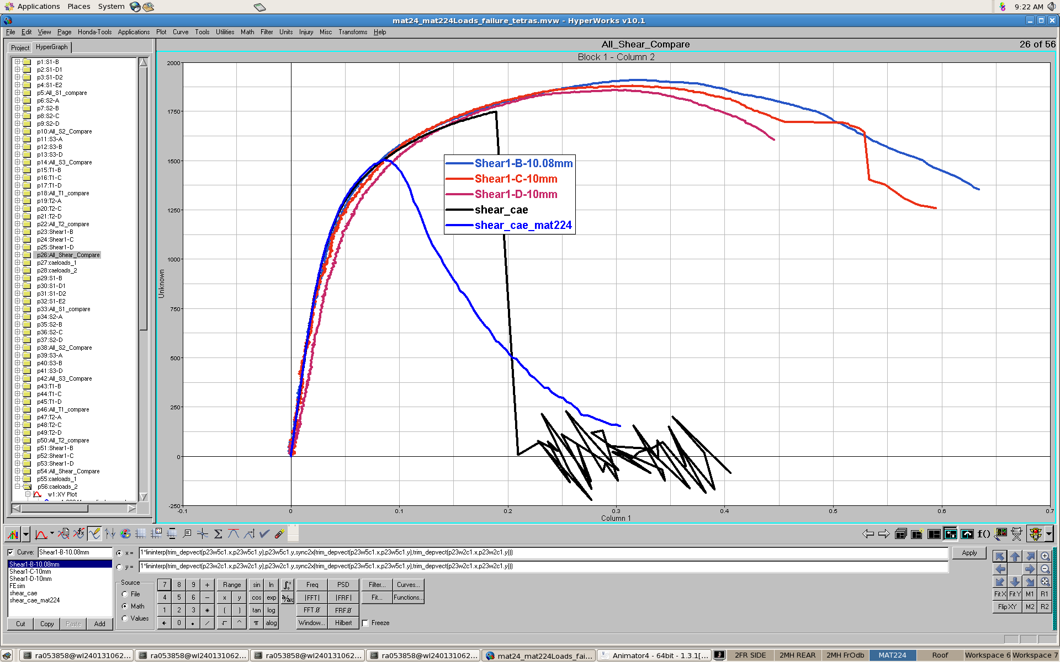
MAT24,224 PS –0.25mm Tet-mesh

Slide 11
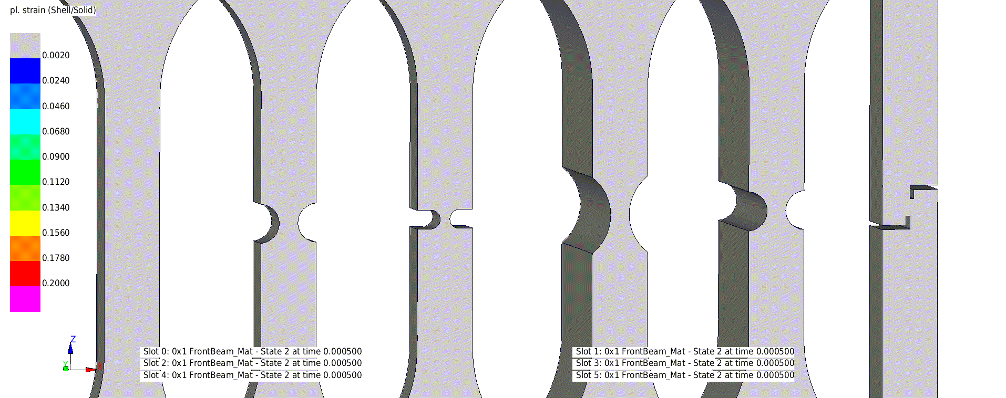
MAT24 PS to Failure - Animation

Slide 12
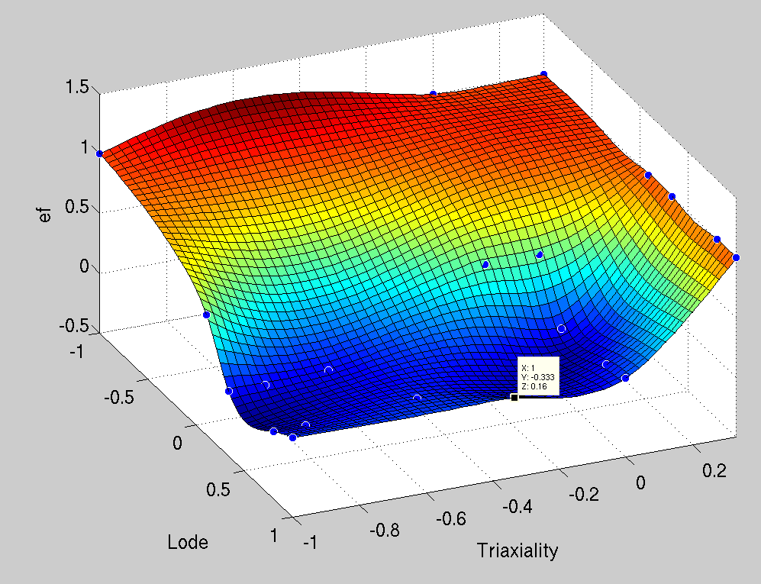
Developed MAT224 Fracture Surface

Slide 13
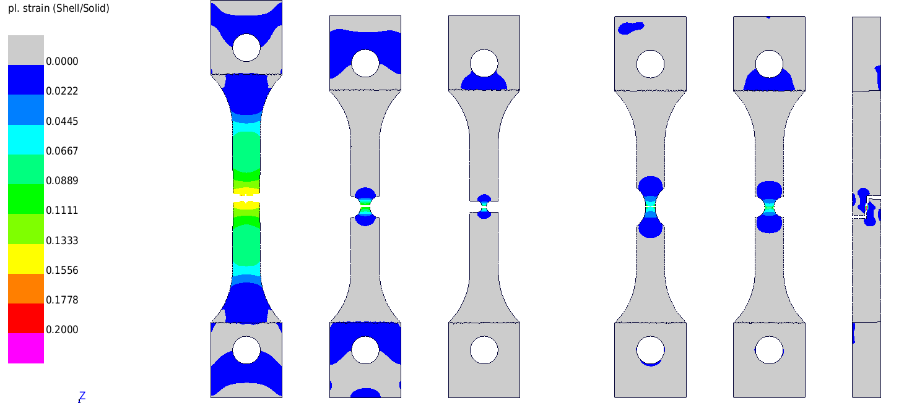
MAT24 Failure

Slide 14
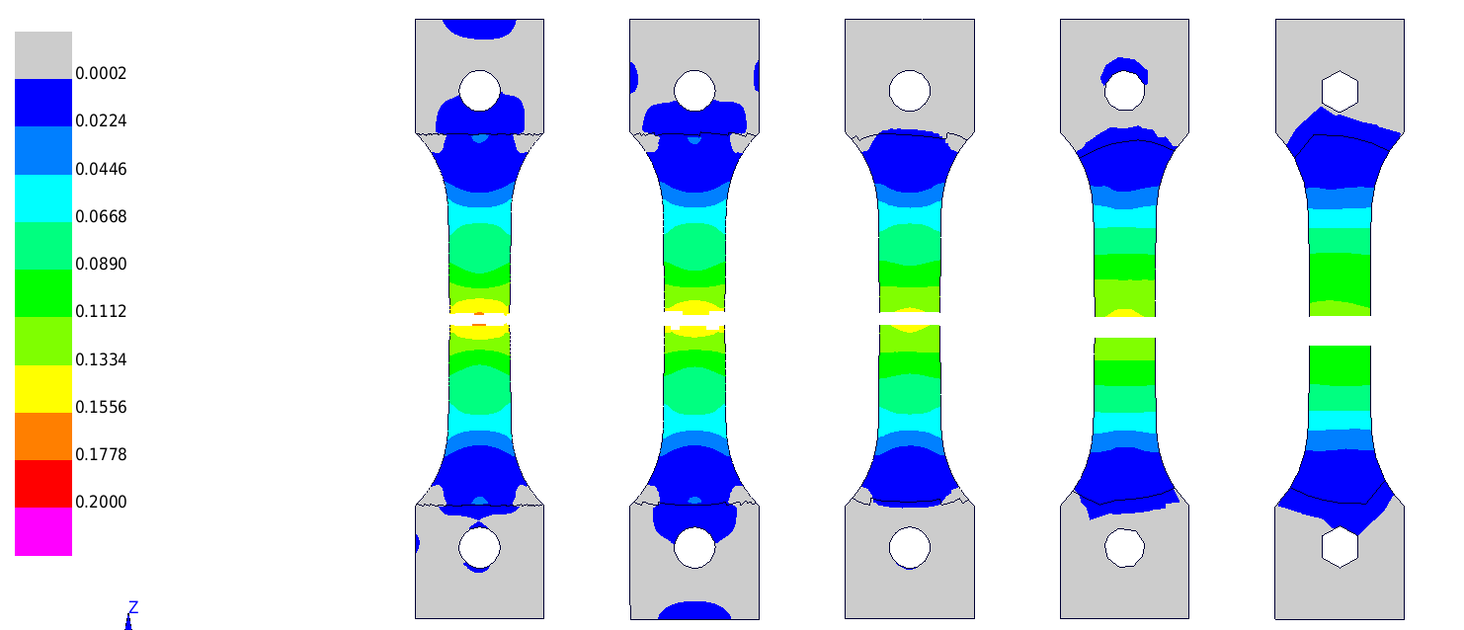
MAT24 Based Regularization
0.224mm
0.450mm
0.899mm
1.500mm
2.868mm
Characteristic length of hex = volume/max surface area

Slide 15
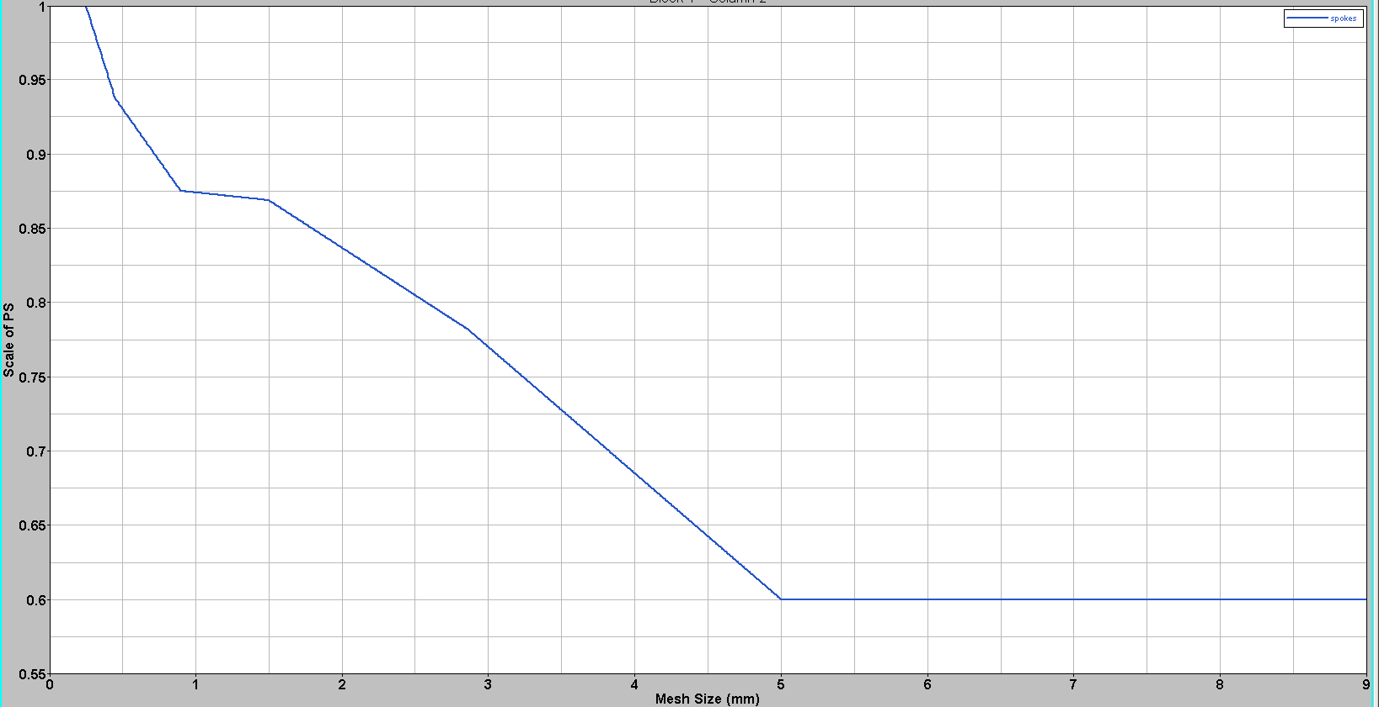
Regularization Curve
Sampling = 200 pts

Slide 16
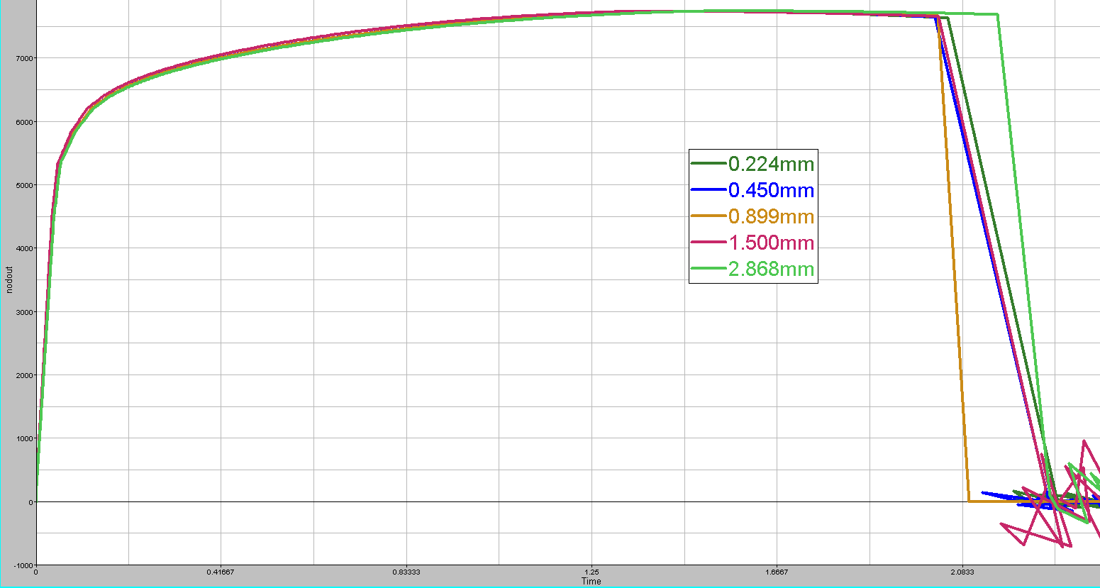

Slide 17
Component Testing

Slide 18
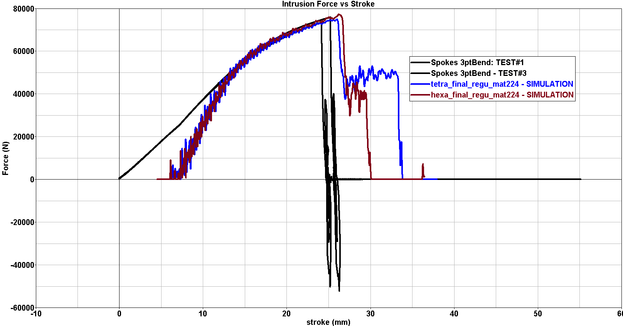
3-point Bending Results

Slide 19
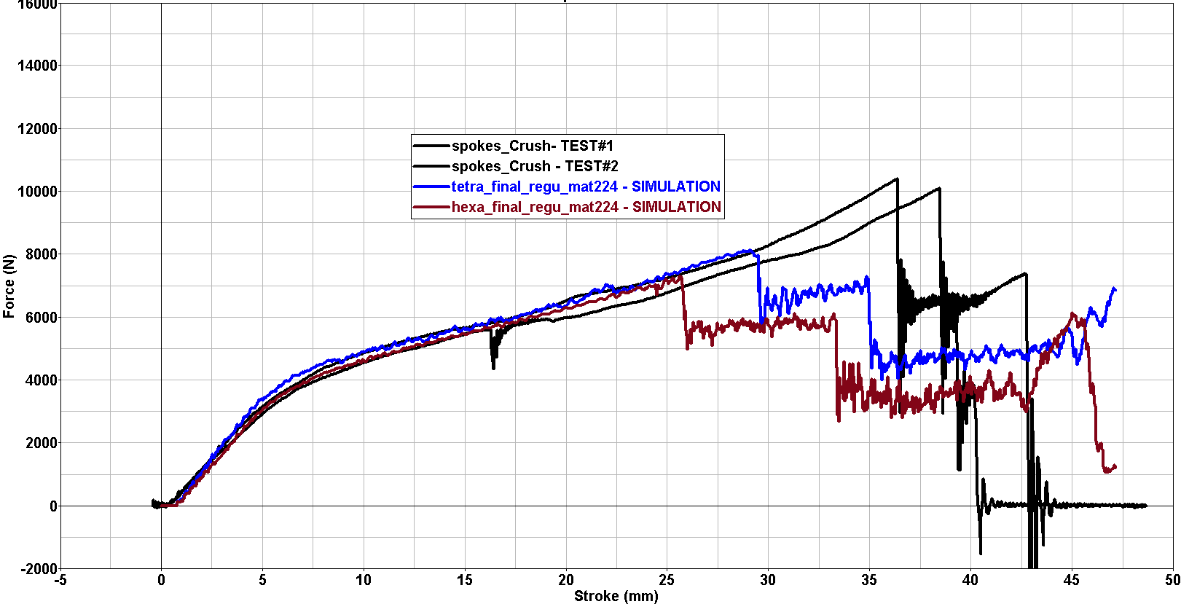
Compression Results

